Slide 1


Sentiment Analysis of Phones sold on Amazon
Rama Danda
DSC 680 - Summer 2021

Slide 2
Domain Background
Phone buyers leave opinion of the products they bought in the form of reviews
Data to be used to gauge the sentiment of the reviewers
Data set is mined from Amazon website for over 400k reviews
Knowing Positive, Negative and Neutral evaluation helps product evaluation over huge volumes and sources

Slide 3
Domain use case
Provide feedback to product owners on how their product is fairing
Give opportunity for service provider to eliminate negative products
Highlight positive sentiment and model them for underperforming products
Use plain text conversion to ratings so to evaluate standardized numbers instead of plain text from blogs and social media posts.

Slide 4
Data sources
Data is provided by https://www.promptcloud.com/ data crawling company
Data source links used for this nalysis:
https://data.world/promptcloud/amazon-mobile-phone-reviews

Slide 5
Defining the features & Target Variable
6 features with two numerical and 4 text
Product Name, Brand Name, Price, Rating, Reviews & Review Votes
Target is
Sentiment on each review text & overall mood of products sold
Positive, negative, neutral
Ratings based on review text
1 to 5

Slide 6
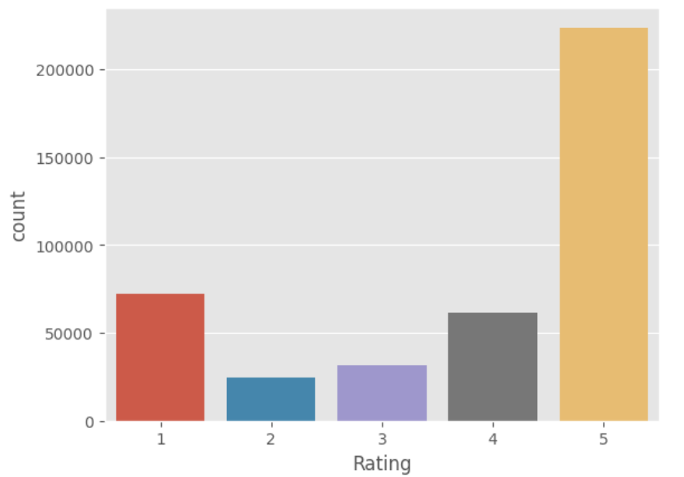
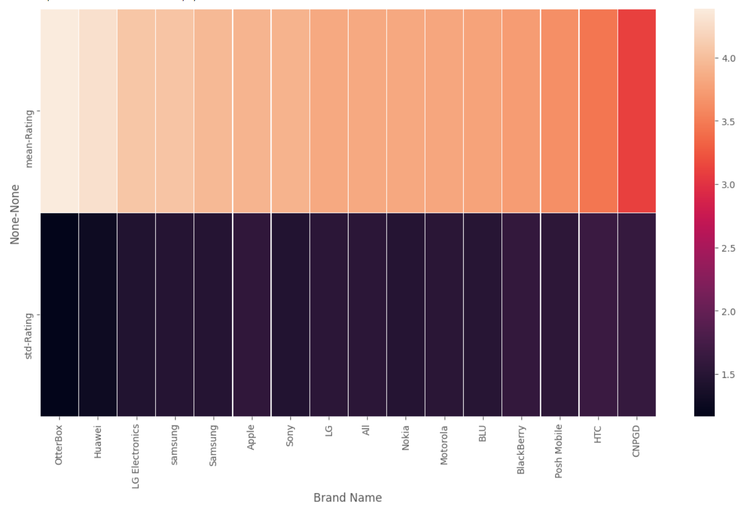
EDA
There more 5star ratings brand phones. Reviewers are extremely happy with the phones or completely dissatisfied with their purchase
Top 15 brands by review counts mean and std rating and is is evident that these OtterBox has the highest mean ratings along with std ratings

Slide 7
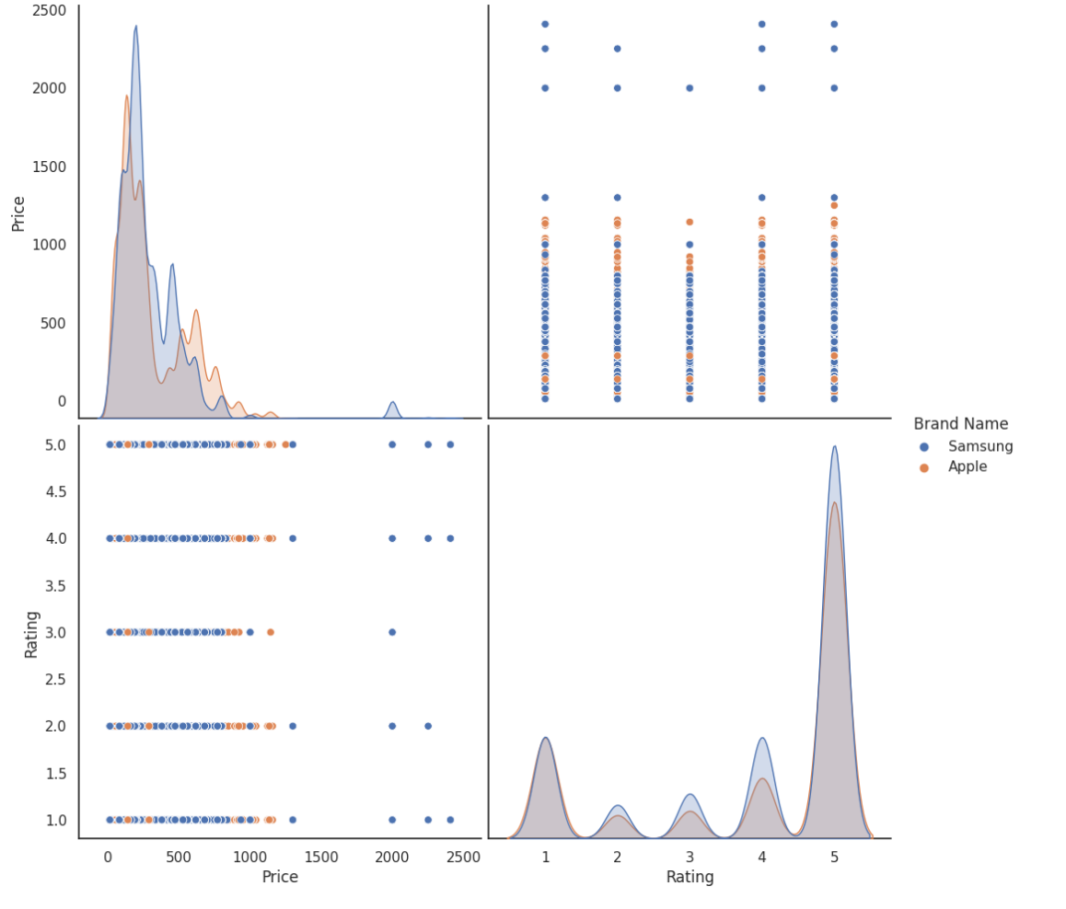
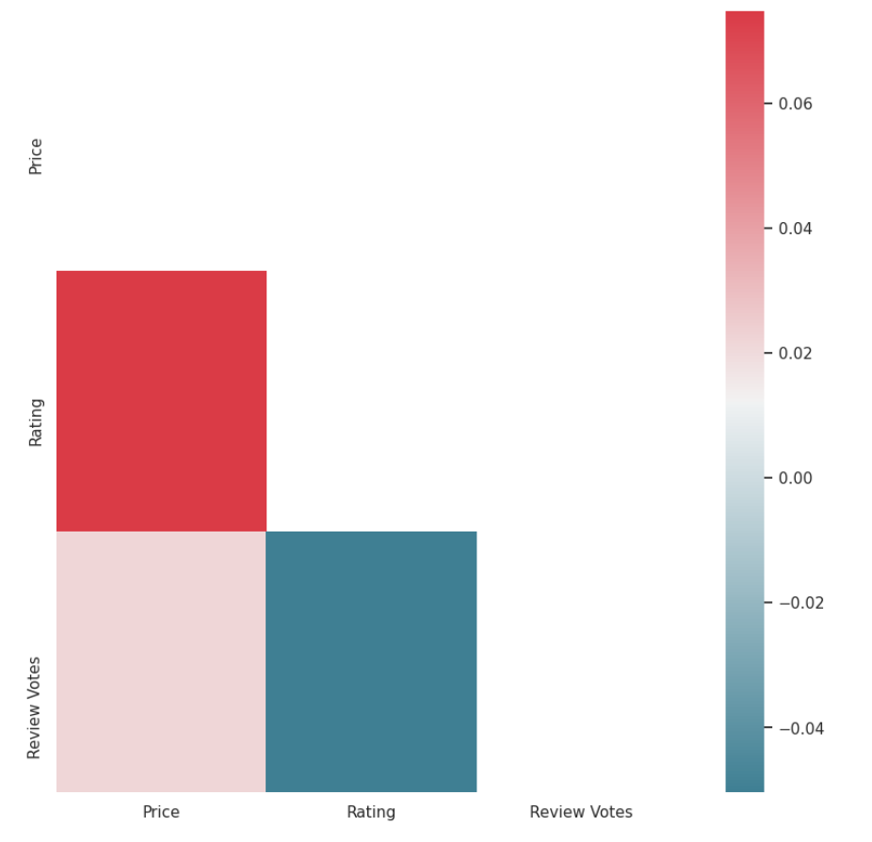
EDA
Stronger correlation followed by price and review votes
Comparing popular brands Samsung has more products at the lower end of the spectrum compared to Apple brand

Slide 8
Data Preparation, transformations & Imputation:
Dropped too short or too long reviews.
Stop word removal, normalized non textual content
Tokenization & lemmatization for predicting the ratings
Bag of words for extraction of features model & TF-ID

Slide 9
Sentiment analysis
Polarity score is used to get a all three positive, negative and neutral
Across the phone brands:
Overall Negative mean 0.05441774840518049 Overall Negative median 0.0 Overall Neutral mean 0.6568210371158152 Overall Neutral median 0.731 Overall Positive mean 0.28805419969073154 Overall Positive median 0.19

Slide 10
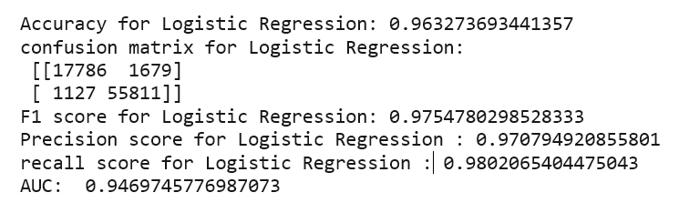
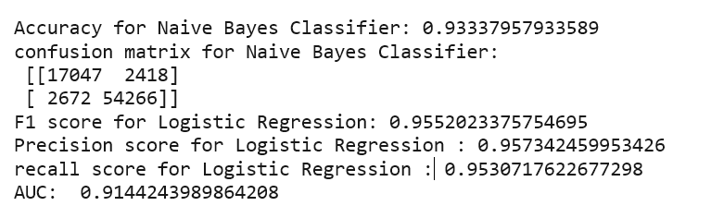
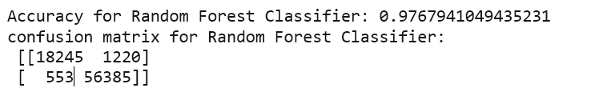
Model building for ratings prediction
Based on these three models, Random forest classifier with 98% accuracy and True positive are higher than other models and false positives are lowest among other models.

Slide 11
Conclusion
65% of neutral mean values in sentiment with normalization of higher 5 and 1 rating
Higher priced product buyers express opinion than low-price products.
Helpful for business to work on improving the sentiments to positive.
Text conversion to ratings help business standardize the ratings among all platforms.
Next step:-
Build more models using LSTM

Slide 12
Acknowledgements & References:
Leveraging Deep Learning for Multilingual Sentiment Analysis
https://www.linkedin.com/pulse/leveraging-deep-learning-multilingual-sentiment-parsa-ghaffari/
Training Deep Convolutional Neural Network for Twitter Sentiment Classification
http://citeseerx.ist.psu.edu/viewdoc/download?doi=10.1.1.703.6858&rep=rep1&type=pdf
Twitter Sentiment Classification using Distant Supervision
https://www-cs.stanford.edu/people/alecmgo/papers/TwitterDistantSupervision09.pdf
Sentiment Classification using Machine Learning Techniques
https://dl.acm.org/doi/pdf/10.3115/1118693.1118704

